Slide 1
Introduction to Data Communications and Networks (CMP 206) Introduction to Computer Networks
Egena Onu, Ph.D.
Department of Computer Science
Bingham University
Karu.

Slide 2
Module Delivery
2 hours of lecture per week.
Exam = 60%
CA = 30%
Attendance = 10%

Slide 3
Module Objective
At the end of this module, you will be able to differentiate the different classifications of computer networks.
Understand:
Computer Architectures
Types of Computer Networks
Local Area Network (LAN) Technologies

Slide 4
Introduction
A system of interconnected computers and computerised peripherals such as printers is called a network.
The interconnection among computers facilitates information sharing.
Computers may connect to one another by either wired or wireless media.
Notes:
27/05/2021

Slide 5
Classification of Computer Networks
Computer networks are classified based on various factors:
Geographical span
Inter-connectivity
Administration
Architecture

Slide 6
Geographical Span
Geographically, a network can be viewed in the following categories:
It may be spanned across a table, among Bluetooth enabled devices covering a few meters.
It may be spanned across an entire building, including intermediate devices to connect all floors.
It may be spanned to cover a city.
It may be one network covering the whole world.

Slide 7
Inter-Connectivity
Components of a network can be connected to each other differently in some fashion.
Connected means either logically, physically, or both ways.
Every single device can be connected to every other device on the network to create a mesh.
All devices can be connected to a single medium but geographically disconnected to create a bus-like structure.

Slide 8
Inter-Connectivity
All devices are connected together to create a star-like structure.
All devices connected arbitrarily using all previous ways to connect each other thereby resulting in a hybrid structure.

Slide 9
Administration
From an administrator’s point of view, a network can be private or public.
A private network is a network that belongs to a single autonomous system and cannot be accessed outside its physical or logical domain.
A public network is one which is accessible to everyone.

Slide 10
Network Architecture
Computer networks can be defined based on different architectures such as client-server, point-to-point and hybrid.
Client-Server
A client-server architecture is one in which two or more computers are connected with one being the client and the other acts as the sever.
The clients request services from the server who in response, provide such services if they are available.

Slide 11
Network Architecture
Point-to-Point
In this network, systems are connected in a point-to-point fashion.
These systems reside on the same level and are called peers.
Hybrid
A hybrid architecture involves the connections that utilises both architectures described earlier.

Slide 12
Network Applications
Computer systems and peripherals are connected to form a network that provide numerous advantages such as:
Resource sharing such as printers and storage devices.
Exchange of information through e-mails and FTP.
Interaction with other users using dynamic web pages.
IP Phones
Video conferencing
Parallel computing
Instant messaging.

Slide 13
Types of Computer Networks
As stated earlier, a computer network is distinguished based on the area it can cover.
A network may cover distance as small between the mobile phone and its Bluetooth earpiece and as large as the entire world.
The types of computer networks include:
Personal Area Network (PAN)
Local Area Network (LAN)
Metropolitan Area Network (MAN)
Wide Area Network (WAN)

Slide 14
Types of Computer Networks
Personal Area Network (PAN):
A PAN is the smallest network and is very personal to a user.
PAN may include Bluetooth enabled devices or infra-red enabled devices.
PAN has a connectivity range of up to 10 meters.
PAN may include wireless computer keyboard and mouse, Bluetooth headphones, wireless printers and TV remotes.
Notes:
PAN – This is the smallest network and it is very personal. PAN has a connectivity range up to 10 meters… e.g wireless keyboard and mouse, wireless headphones, printers, TV remotes
LAN – This is the second smallest network that covers inside a building and is operated under a single administrative system. It connects from 2 to 6 million devices
MAN – This is a computer network that covers an entire. It uses Ethernet, Token-ring, ATM, FDDI. The backbone of MAN is a high-capacity and high-speed fibre optics
WAN – This computer network covers a large area such as a province or a country. These networks provide connectivity to MANs and LANs. WAN uses ATM, frame relay, and SONET

Slide 15
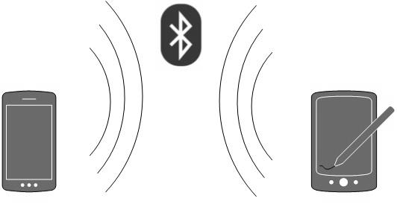
Types of Computer Networks
Personal Area Network (PAN):
PAN may take up eight devices in a master-slave fashion.

Slide 16
Types of Computer Networks
Local Area Network (LAN):
LAN is a computer network that covers inside a building and operated under a single administrative system.
LAN covers an organisation’s offices, colleges or universities.
The number of systems connected in LAN may vary from two to as much as 16 million.

Slide 17
Types of Computer Networks
Local Area Network (LAN):
LAN provides a useful way of sharing resources between end users.
These resources include: printers, scanners, and the internet that are sharable among computers.
LANs are composed of networking and routing equipments such as hubs, switches and routers.
A LAN may contain local servers serving file storage and other locally shared applications.

Slide 18
Types of Computer Networks
Local Area Network (LAN):
A LAN mostly operates on private IP addresses and does not involve heavy routing.
LAN works under a local domain and controlled centrally.
LAN uses either Ethernet or Token-ring technology.
Ethernet is the mostly widely employed LAN technology.
A LAN can be wired, wireless or in both form at any time.

Slide 19
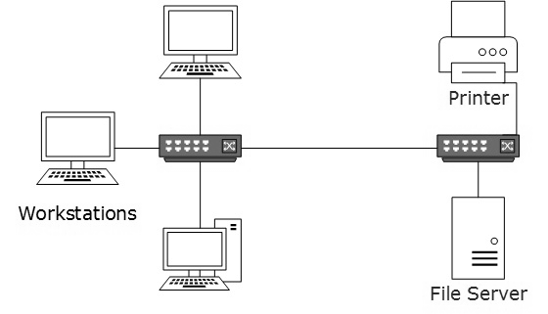
Types of Computer Networks

Slide 20
Types of Computer Networks
Metropolitan Area Network (MAN):
MAN is a computer network that covers an entire city, such as cable TV networks.
MAN can use Ethernet, Token-ring, Asynchronous Transfer Mode (ATM), or Fiber Distributed Data Interface (FDDI).
Metro Ethernet is a service provided by ISPs.
This service enables users to expand their LANs.
For example, MAN can help an organisation to connect all of its offices in a city.

Slide 21
Types of Computer Networks
Metropolitan Area Network (MAN):
The backbone of a MAN is a high-capacity and high-speed fiber optics.
MAN works in between LAN and Wide Area Network (WAN).
MAN provides the uplink for LANs to WANs or internet.

Slide 22
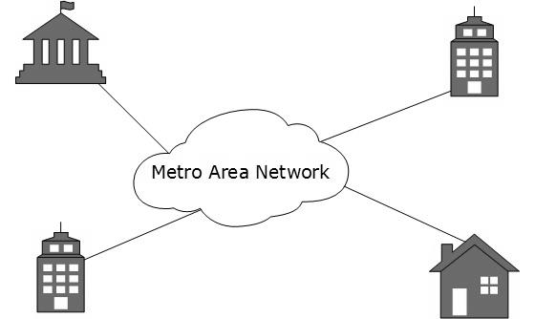
Types of Computer Networks

Slide 23
Types of Computer Networks
Wide Area Network (WAN):
WAN covers a large area which may be a province or a country.
Telecommunication networks are WANs.
These networks provide connectivity to MANs and LANs.
WANS are equipped with high speed backbone.
WAN may use advanced technologies such as Asynchronous Transfer Mode (ATM), Frame Relay, and Synchronous Optical Network (SONET).
WAN may be managed by multiple administration.

Slide 24
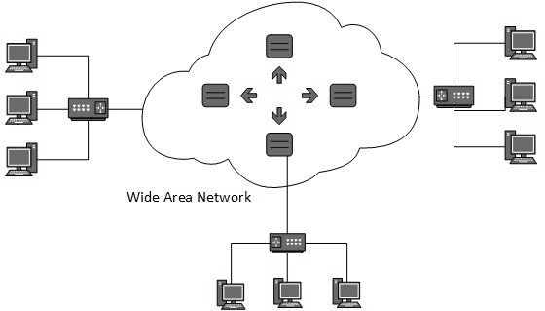
Types of Computer Networks

Slide 25
Types of Computer Networks
Internetwork:
Internetwork is the network of networks and simply referred to as Internet.
The internet is the largest network on the planet.
It connects all WANs thus bringing connections to homes and offices AKA LANs.
The Internet uses TCP/IP protocol suite and uses IP as the addressing protocol.

Slide 26
Types of Computer Networks
Internetwork:
The internet allows users to share and access enormous amount of information using World Wide Web (WWW), FTP, email services, audio and video streaming services and a host of others.
The internet is based on the client-server architecture.
Internet uses high speed fiber optics backbone as the medium of transmission.

Slide 27
Types of Computer Networks
Internetwork:
To inter-connect the various continents, fiber optic cables are laid under the sea and referred to as “submarine communication cables”.
Internet is widely deployed on the WWW services using HTML linked pages and accessible by client software known as the Web Browsers.

Slide 28
Types of Computer Networks
Internetwork:
The internet serves many purposes and is involved in many aspects of our lives such as:
Web sites
E-mail
Instant messaging
Blogging
Social Media
Marketing
Networking
Resource sharing
Audio and Video streaming.

Slide 29
LAN Technologies
Ethernet:
Ethernet is a standard networking architecture that defines the physical layout, lengths, and types of media that can be used. There are many variations of Ethernet but the most used is the CSMA/CD network access method.
The Ethernet technology is a widely deployed LAN.
Ethernet was invented in 1970 by Bob Metcalfe and D. R. Boggs.
It was then standardised in the IEEE 802.3 in 1980. This is why it mostly known as the 802.3 LAN.

Slide 30
LAN Technologies
Ethernet:
Ethernet uses the 10BASE-T specification.
Here, 10 stands for 10Mbps, BASE translates to baseband and T is for Thick Ethernet.
Ethernet technologies provide speed up to 10Mbps using Cat-5 cable.
Some of these technologies include:

Slide 31
LAN Technologies
Ethernet:
Fast-Ethernet
Fast-Ethernet emerged as a result of the growth in emerging technologies.
The technology was introduced in 1995.
This technology runs on UTP, optical fiber and wireless medium.
Fast-Ethernet offers speed up to 100Mbps.
By standardisation, the technology is referred to as the 100BASE-T in the IEEE 803.2 and uses mostly twisted pair cables.
On fiber optics cables, fast Ethernet goes up to 100 meters in half duplex mode and a maximum of 2000 meters in full-duplex multimode fibers.

Slide 32
LAN Technologies
Ethernet:
Giga-Ethernet
Giga-Ethernet provides speed up to 1000 Mbps.
In the IEEE standard, it is known as the IEEE802.3ab using Cat-5 UTP while IEEE802.3ah represents Giga-Ethernet over fiber.

Slide 33
Questions!!!

